Slide 1

Social Media in the Workplace
30
Years of Co-op
at the Mount
DeNel Rehberg Sedo
Notes:
Thank Donna Bourne-Tyson, MSVU University Librarian and Denyse Rodrigues, who continue to be my links to all things social media and a darn good colleagues and friends.

Slide 2

Today’s Take Aways
The Good
The Bad
The Ugly

Slide 3
What has happened to us is an amazing invention -- computers and the internet and TV. It is a revolution. This is not the first revolution the human race has dealt with. The printing revolution, which did not take place in a matter of a few decades, but took much longer, transformed our minds and ways of thinking. A foolhardy lot, we accepted it all, as we always do, never asked, What is going to happen to us now, with this invention of print? In the same way, we never thought to ask, How will our lives, our way of thinking, be changed by this internet, which has seduced a whole generation with its inanities so that even quite reasonable people will confess that once they are hooked, it is hard to cut free, and they may find a whole day has passed in blogging etc.
Doris Lessing
Acceptance Speech
The Nobel Prize
in Literature
2007

Slide 4
The Good
Social Media
is
changing the way we communicate.

Slide 5
Social Media
A Revolution?

Slide 6
Brian Solis’ Conversation Prism
http://theconversationprism.com/1900

Slide 7
RSS
Feedburner statistics
Top feeds at the bloglines RSS aggregator
Really simple syndication
(one of many acronyms)
XML Protocol which allows for the subscribing to new content (blogs, podcasts, screencasts, and other content from database based web content

Slide 8
BLOGS
Wikipedia on “blogs”
Employee commentary on corporate products and events
Organization's communication with the public
A Blog-Off
individual online journals with commentary on a variety of topics from personal to political; leisure to career.

Slide 9
FOLKSONOMIES /TAGGING
FLICKR - image sharing/showcasing
43 Things - social networking
YouTube - video sharing/showcasing
del.icio.us - social bookmarking
Wordle – the art of tagging
a practice of collaborative categorization using freely chosen keywords

Slide 10
PODCAST
Mount Saint Vincent University Distance Learning's 5 Mount Minutes series
Screencast - mp3 files accompanied by screen shots
Vidcast /Vodcast/Webcast - streaming video
New Oxford American Dictionary selected 'podcast' as the Word of the Year for 2005. Podcast, defined as "a digital recording of a radio broadcast or similar program, made available on the Internet for downloading to a personal audio player."

Slide 11
WIKIs
The power of collaboration
The problem with collaboration?
Another insight
Four ways to use wikis for project management
Which wiki will you use?
collaborative websites that can be easily edited

Slide 12
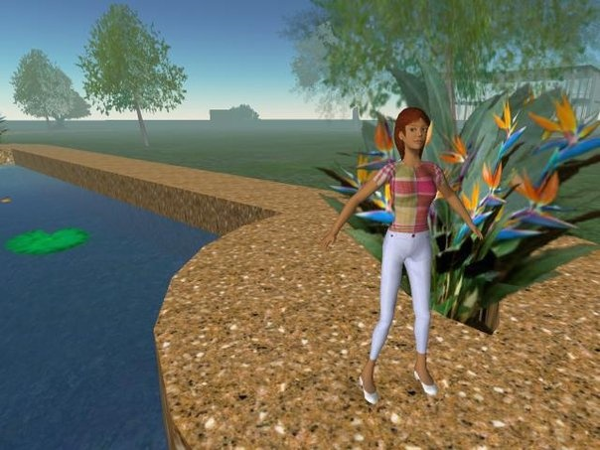
ONLINE VIRTUAL ENVIRONMENTS
Second Life - 3D virtual world

Slide 13
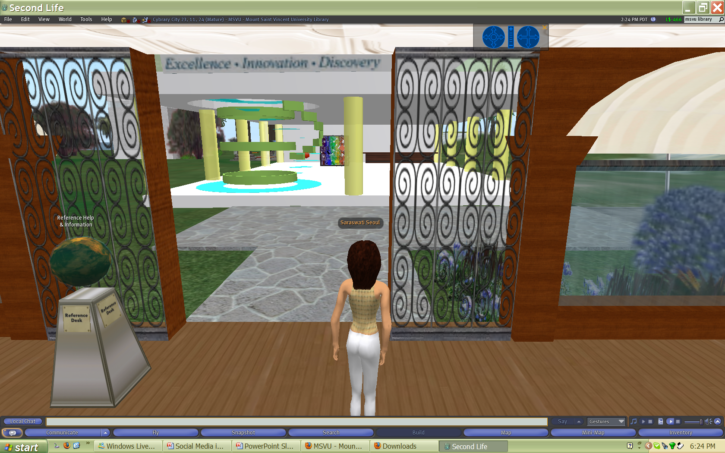

Slide 14
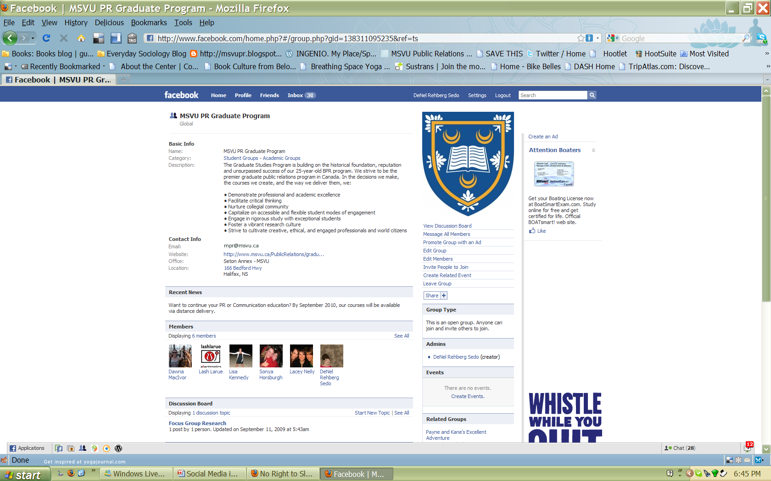
Social Networking Sites

Slide 15
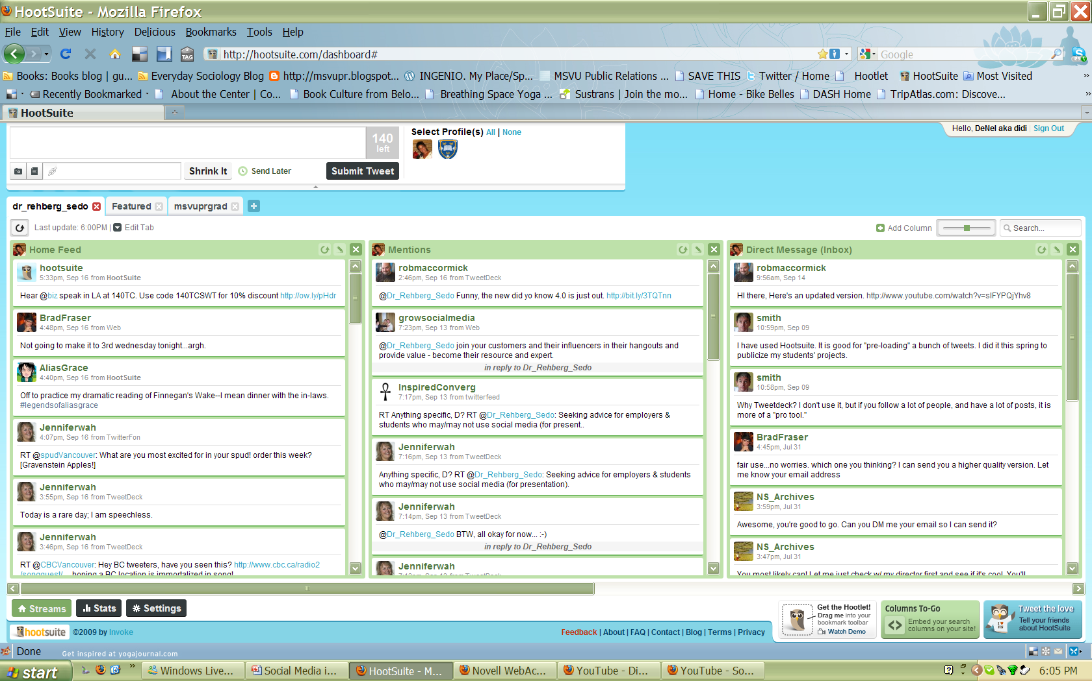

Slide 16
Web 2.0/3.0 use in Organizations
More Examples
Case studies
More case studies
Sonic Foundry training examples
900 Sign On to Write Wikipedia-Style Management Book
Penguin books market Snow Crash in Second Life
Amazon - employs user tags
10 ways to use blogs for managing projects
Social media trumps porn for Internet use
(a shorter version)

Slide 17


Who is using Social Media?
ThinkWell Research
StatsCanada

Slide 18
Online Research Resource
Pew Internet & American Life Project

Slide 19
The Bad
Social Media
is
changing the way we communicate.

Slide 20
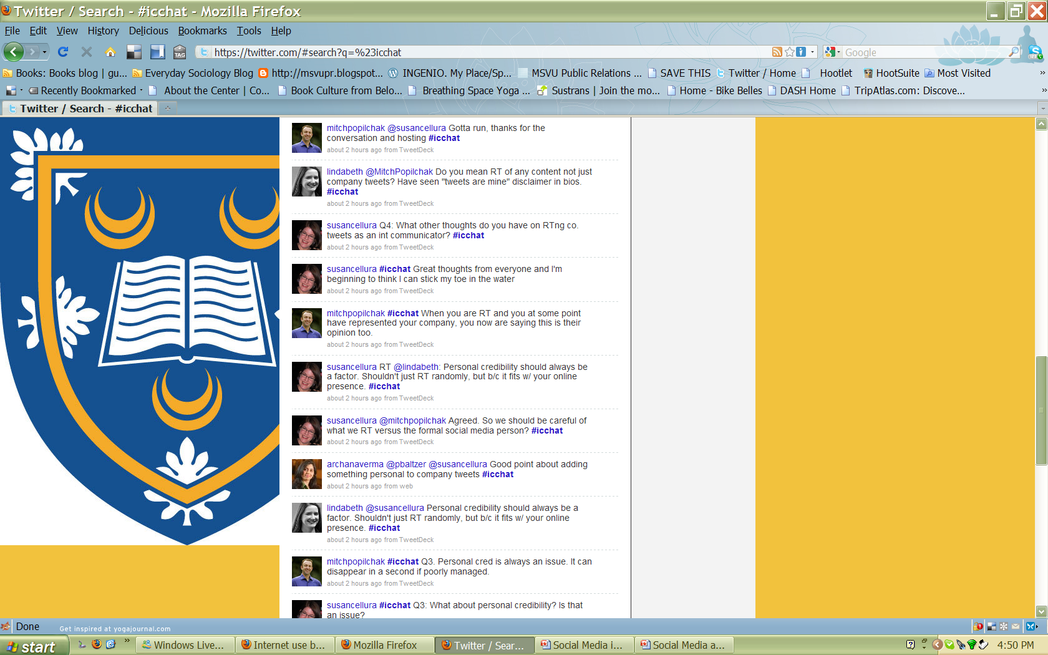

Slide 21
Changes Happen Fast

Slide 22
The Ugly

Slide 23
The Ugly
(or, the points that make us uneasy)
Privacy
Slacktivism
Copyright issues
Slander
Ownership – Who owns social media content?

Slide 24
Your turn.
The Good
The Bad
The Ugly

Slide 25
For a Copy of the Slide Presentation, complete with Links…
Visit:
denelrehbergsedo.wordpress.com

