Slide 1
Social Media 101
Presentation for the
Anglican Editors Association
29 May 2010
DeNel Rehberg Sedo, PhD, Communication

Slide 2
Overview
Facts & Figures
Examples
Advice
Discussion

Slide 3
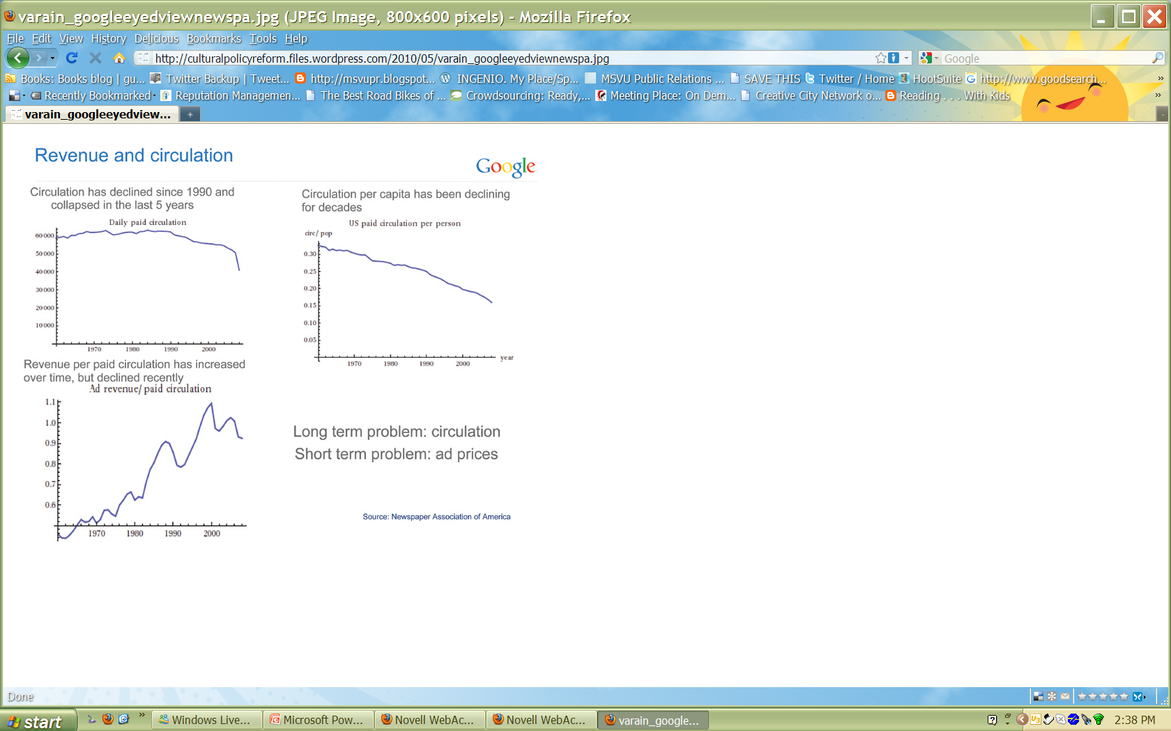

Slide 4

Social Media: Library of Parliament Background Paper

Slide 5
Social Media: One thing is not just like the other one
Did you know? 4.0
Communication Revolution
My POV
  Celebratory
  Cautionary
  Critical
Notes:
http://www.youtube.com/watch?v=6ILQrUrEWe8

Slide 6
Social Media: One thing is not just like the other one
Did you know? 4.0
Communication Revolution
My POV
  Celebratory
  Cautionary
  Critical
Notes:
1. Read Doris Lessing
2. an overthrow or repudiation and the thorough replacement of an established government or political system by the people governed.
2.Sociology. a radical and pervasive change in society and the social structure, esp. one made suddenly and often accompanied by violence. Compare social evolution.
3.a sudden, complete or marked change in something: the present revolution in church architecture.
4.a procedure or course, as if in a circuit, back to a starting point.
5.a single turn of this kind.

Slide 7
Social Media: One thing is not just like the other one
Did you know? 4.0
Communication Revolution
My POV
  Celebratory
  Cautionary
  Critical
Notes:
Identity
Access
Privacy
Political Economy
Literacy

Slide 8
Social Media: One thing is not just like the other one
  Celebratory
  Cautionary
  Critical
    Community
    Communication
    Commerce
Notes:
Identity
Access
Privacy
Political Economy
Literacy

Slide 9
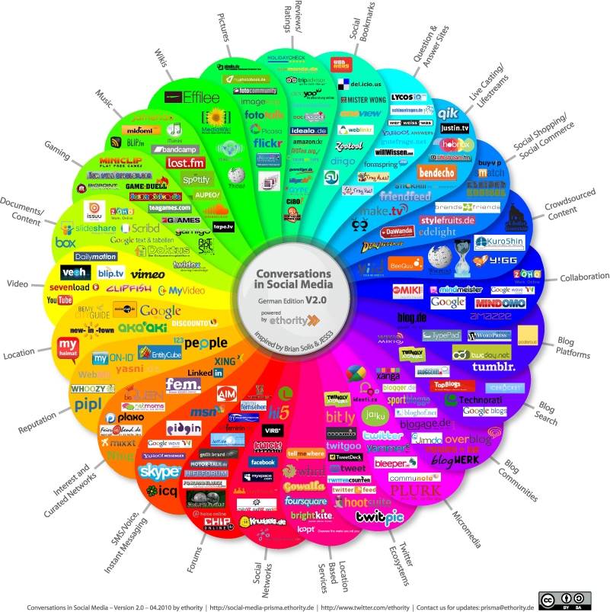
Solis’s
Conversation
Prism

Slide 10
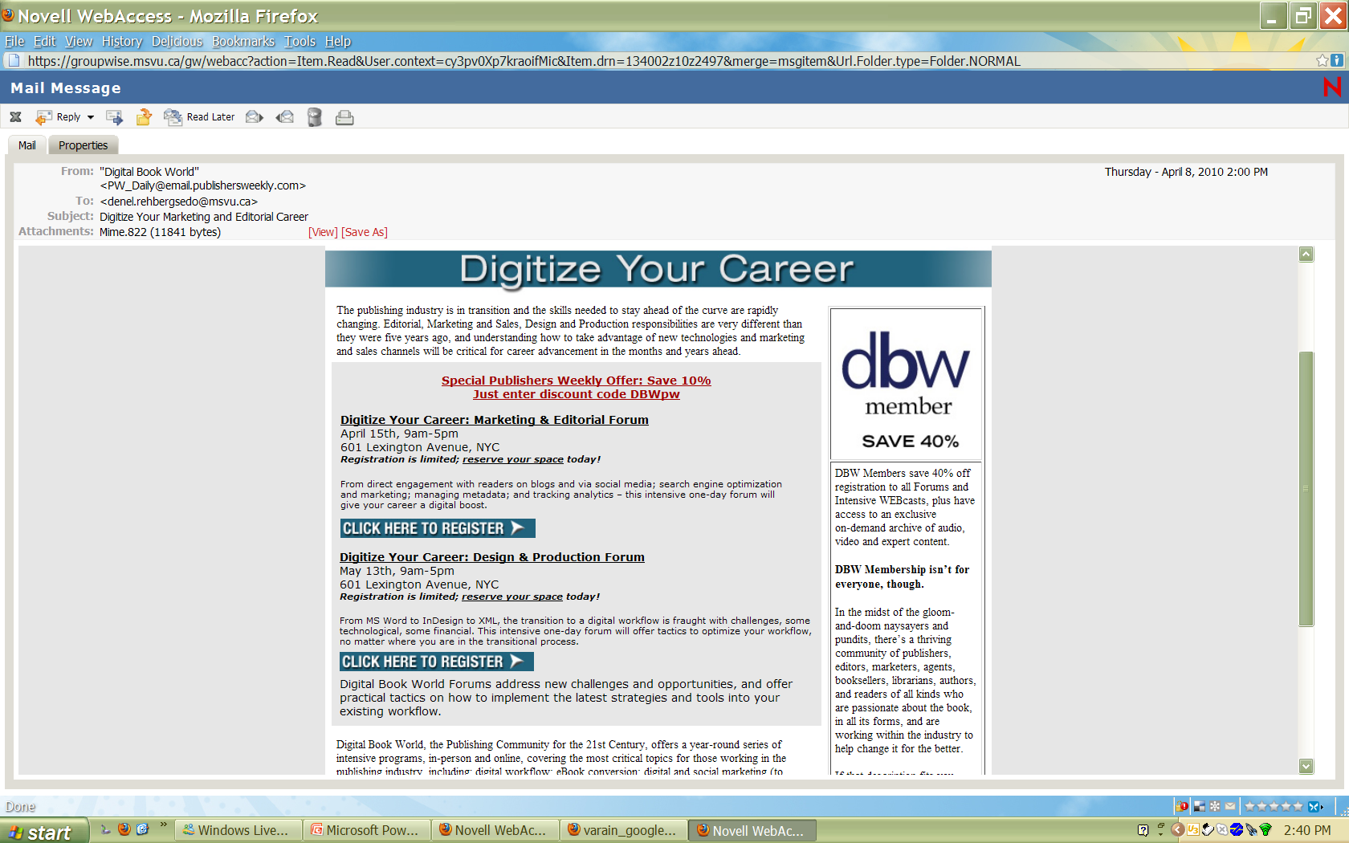
Any copy that appears with a photo should be set under the photo to ensure clarity.

Slide 11
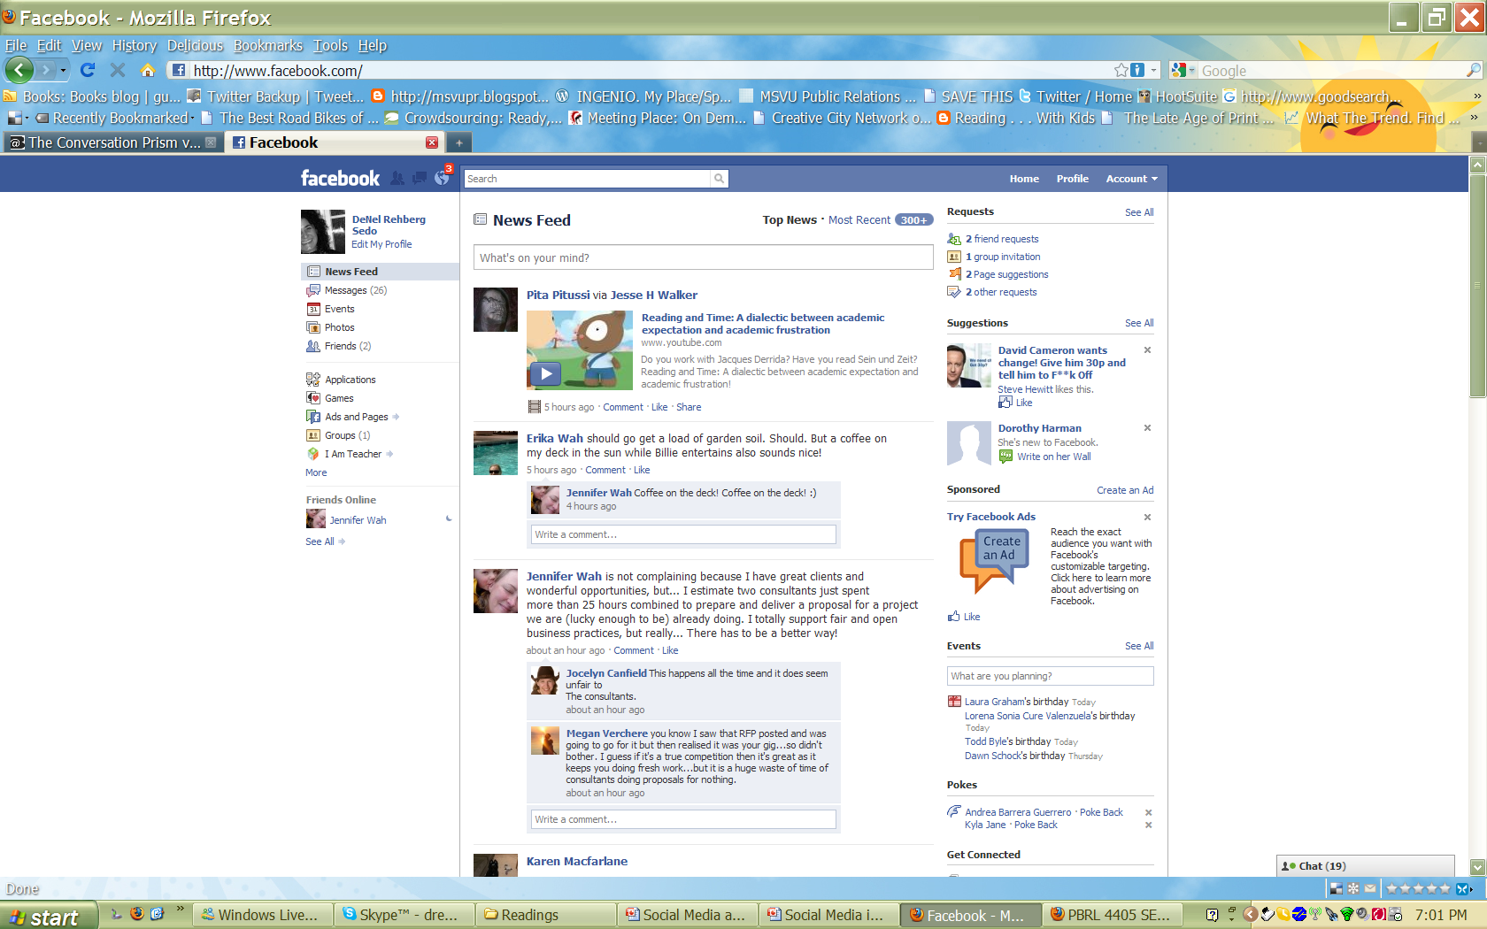
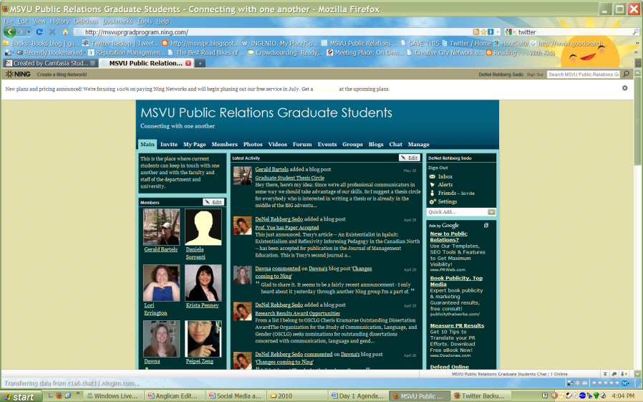
Social Networking Sites

Slide 12
Blogs
Wikipedia on “blogs”
Employee commentary on corporate products and events
Organization's communication with the public
(Example 2)
individual online journals with commentary on a variety of topics from personal to political; leisure to career.
Evolution: Blog platforms to blog /conversation to blog communities

Slide 13
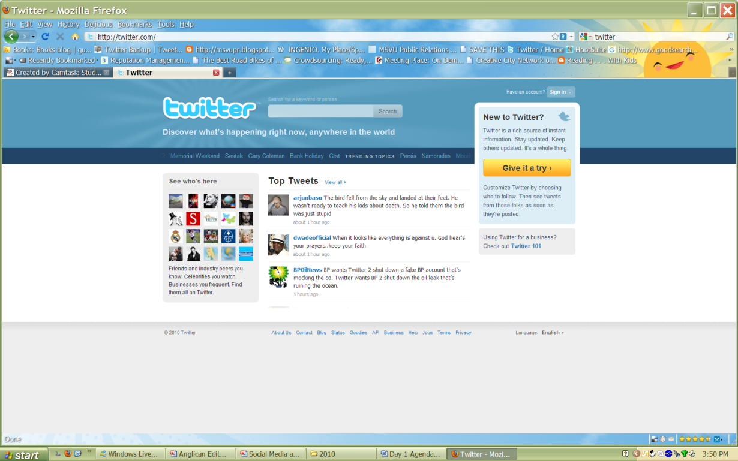
MicroBlogging
(Twitter)
http://twitter.com/
Twitter basics
Evolution:
Twitter Ecosystem
TweetDeck
HootSuite
TweetBackup

Slide 14
Podcast
Radio on demand
Special interest on demand
Screencast - mp3 files accompanied by screen shots
Vidcast /Vodcast/Webcast - streaming video
New Oxford American Dictionary selected 'podcast' as the Word of the Year for 2005. Podcast, defined as "a digital recording of a radio broadcast or similar program, made available on the Internet for downloading to a personal audio player."

Slide 15

RSS
Specific interests
Really simple syndication ( one of many acronyms)
XML Protocol that allows for the subscribing to new content (blogs, podcasts, screencasts, and other content from database based web content)

Slide 16
The Pros & Cons
social/cultural component
extremely flexible and easy to use
allows for easy creation and dissemination of information both internally and externally
social / cultural challenges
technical challenges
time
Notes:
Technical challenges
Excellent for new materials but retrieval of older items not as sophisticated
Social / Cultural challenges
Employers and employees can come into conflict regarding blog content
Joyce Park was allgedily fired from Friendster because of a blog posting.
Niall Kennedy self censored his blog at the request of his employer.
How to Blog Safely (About Work or Anything Else) published by the Electronic Frontier Foundation (EFF)
Wikis require an active editor as anyone can modify the pages
Quality blogging takes a lot of commitment on the part of the blogger. Readers can quickly spot marketing speak.
Center for Marketing Research (2006) Behind the Scenes in the Blogosphere: Advice From Established Bloggers. [Report]
Is there an environment of trust; a culture of collaboration?Are there incentivives for participation?Are the content expectations clear? Are intellectual property concerns addressed?

Slide 17



Getting Started
Research
Prioritize
Involve community to create community
Monitor/Evaluate
  Listen
  Track participation/loyalty
Adapt
Notes:
T-Mobile Sing-along Trafalgar Square (extended version)

Slide 18
Discussion

Slide 19
Thank you. Together, we are wise.
DENEL.REHBERGSEDO@MSVU.CA, DENELREHBERGSEDO.WORDPRESS.COM

